Slide 1


Progress Of The
Viral Hepatitis
Elimination Program
In Georgia
Maia Tsereteli, MD, PHD
National Center for Disease Control and Public Health, Georgia
WHO Collaborating Center for Viral Hepatitis Elimination (GEO-3)

Slide 2
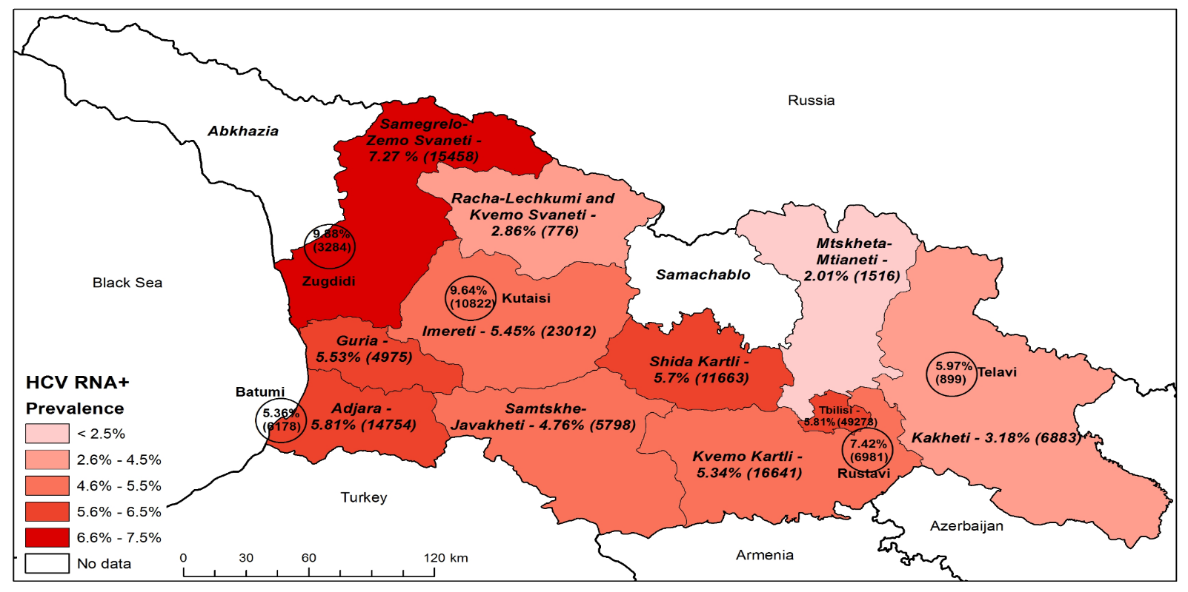
Epidemiology of hepatitis C in Georgia, 2015-2021
The 1st National Serosurvey on Hepatitis C conducted in Georgia in 2015 showed a prevalence rate of HCV RNA in 5.4% of the adult population
In 2021, the NCDC in close partnership with the U.S. CDC conducted 2nd nationwide serosurveys on hepatitis B and C.
In 6 years, the prevalence of chronic HCV infection has decreased by 67% (from 5.4% in 2015 to 1.8% in 2021)
Figure 1: Prevalence and Estimated Number of HCV RNA+ Individuals by Regions and Cities, 2015
Table 1: 2015 and 2021 National Serosurvey for Hepatitis B and C in Georgia
Characteristics | Adults 2015 | Adults 2021 | Children 2021
Anti-HCV+ | 7.7% | 6.8% | 0%
HCV RNA + | 5.4% | 1.8% | 0%

Slide 3
Timeline Of Key Activities Under The
Hepatitis C Elimination Program In Georgia
Showed by conducted Population-based Serosurvey of Prevalence and Risk Factors for SARS-CoV-2, HCV, and HBV
67% decrease In prevalence
HBV state program drafted
A 10-year agreement between Gilead and the GOG signed
First National Strategy 2016–2020 approved
Diagnostics available and free of charge
Decentralization
of HCV Diagnostic, Care, and Treatment Services to PHC and HR services
Georgia named EILF Center of Excellence in Viral Hepatitis Elimination
All diagnostics free of charge
2016
2018
2020
2022
2024
2015
2017
2019
2021
2023
Launch of the elimination Program
Nationwide serosurvey: 5.4% adults with chronic HCV
Beginning of National screening program
Georgia awarded the title of NOhep Visionary for the European Region at the 2017 WHS
A pilot project – Integration of HCV, TB, and HIV Detection at PHC level initiated
The linkage-to-care program initiated
NCDC is designated as the WHO CC on Viral Hepatitis Elimination
National Strategy 2021–2025 updated
HBV workgroup established
HBV state program approved
Notes:
The program set eligibility criteria for treatment initiation.
Patients flow was extremely high at the beginning of the elimination program
Only 4 treatment sites were available for service delivery
Number of specialists was also limited
Treatment regimens contained IFN, making difficult for a physician to manage many patients at the same time

Slide 4
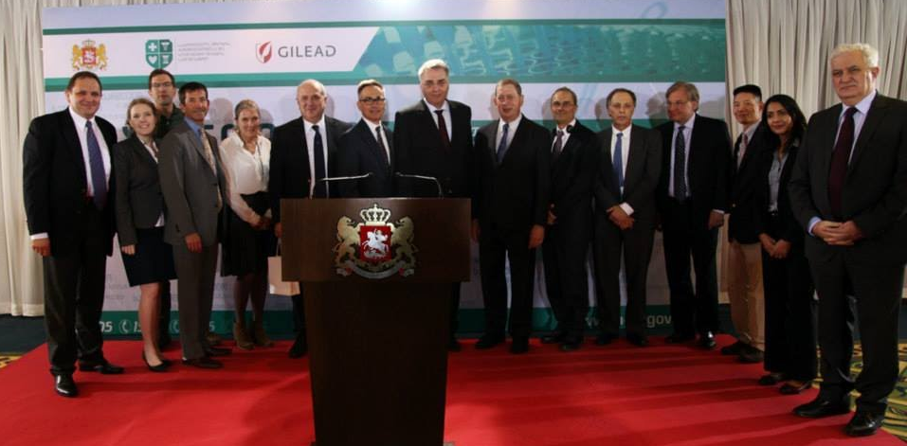
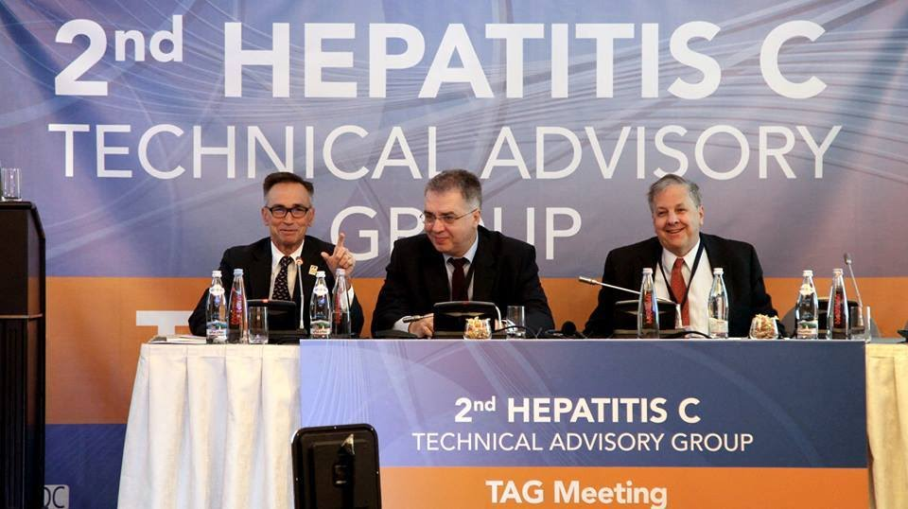
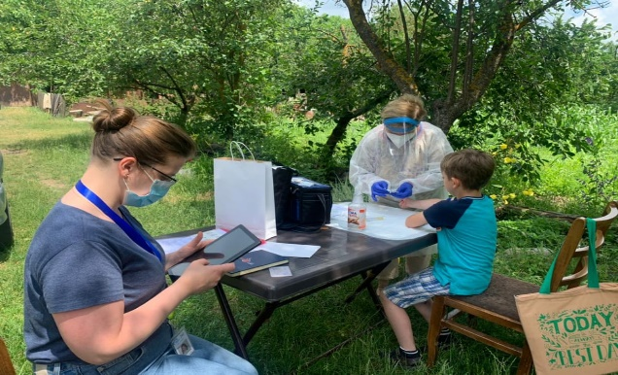
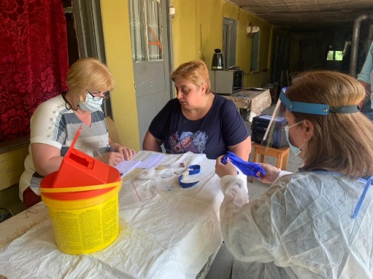
Key Achievements
Development and implementation of the working Strategic Plans, as well as clinical guidelines and laboratory SOPs to support viral hepatitis elimination
The Technical Advisory Group (TAG) composed of 12 international experts, was established. Every year, TAG discusses the progress towards elimination, monitors and evaluates indicators and provides recommendations on long-term elimination strategy.
Conducting two nationwide serosurveys to estimate and monitor the progress of the burden of HCV and HBV infections

Slide 5


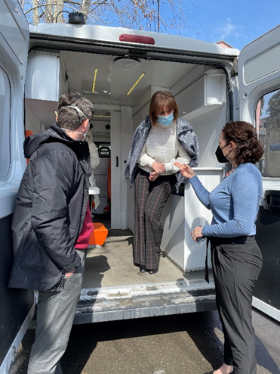
Initiation of massive awareness campaigns
Creation and management of integrated electronic HCV registries
Decentralization of testing and treatment: Currently 39 centers in different cities (including in penitentiary system) are providing diagnostic and treatment services
Universal donated blood screening for HCV and HBV using Nucleic Acid Testing (NAT) implemented
Introduction of the External Quality Assessment (EQA) system for laboratory diagnostics
Establishment of the Clinical and Scientific Committees for the transparency and coordination of the research activities within Hepatitis C Elimination Program in Georgia
Notes:
Highlights of Initiated Activities

Slide 6
Hepatitis C Elimination Program in Georgia:
Best Practices
Strong Political Commitment
Decentralization and simplification of access to testing & treatment
International partnerships
Electronic Registries
Enabled the implementation of important policies and regulations
Aided the intersectoral collaboration, including the public-private partnerships
Mass public awareness campaigns
Donation of the Medication
Technical advisory group (TAG)
2 nationwide serosurveys in 2015 & 2021
Free wide-scale screenings at various settings
Point-of-care viremic testing and HCV treatment are free of charge and widely available
Simplified patient management
Established to collect real-time data for testing and treatment progress of the enrolled individuals
Availability of the free and effective treatment
Increased public interest towards testing
Reduced Stigma towards disease
1
2
3
4
5

Slide 7
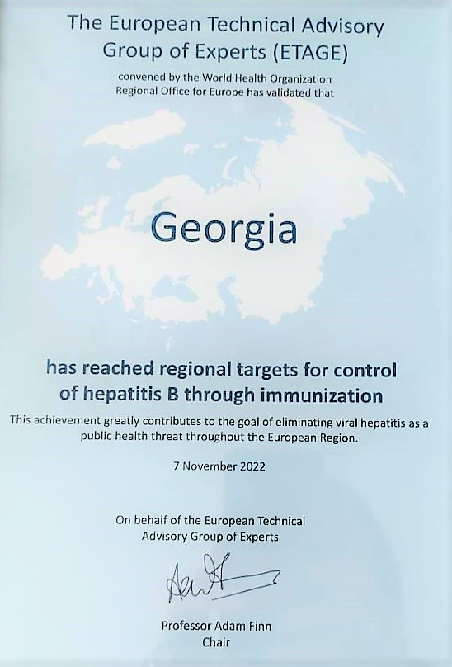

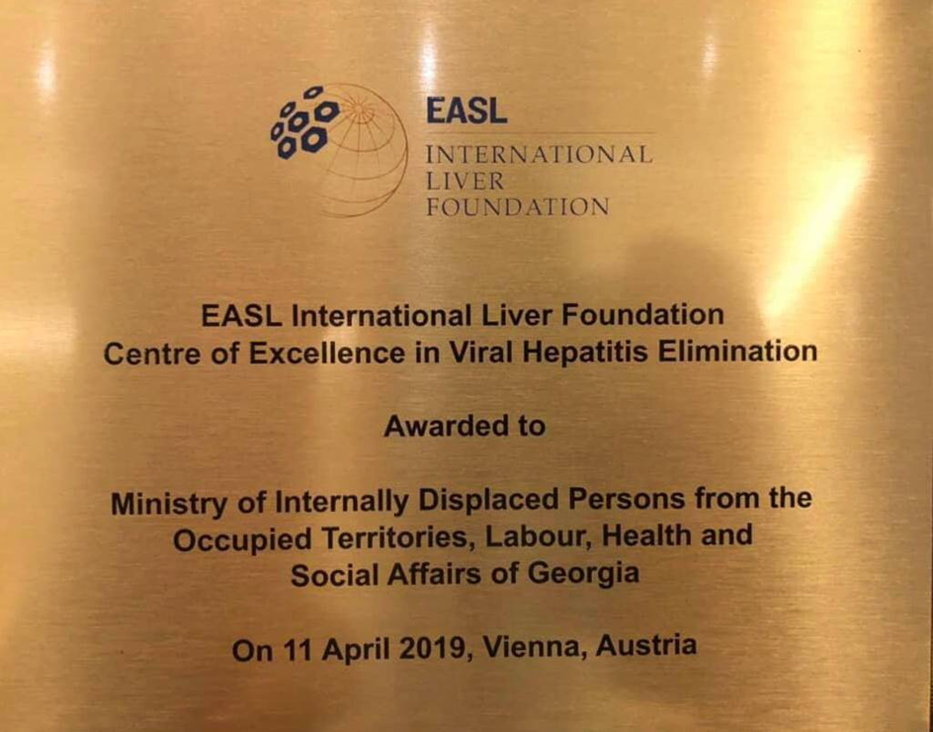

International Recognition
Salford & Co.
Georgia was awarded the title of NOhep Visionary for the European Region at the World Hepatitis Summit in Sao Paulo, Brazil, on November 1st, 2017
In April 2019 EASL meeting in Vienna was dedicated to Georgia and country was awarded with the status of the Center of Excellence
Program received recognition by the CDC Director – Honor Award for Excellence in Partnering

Slide 8
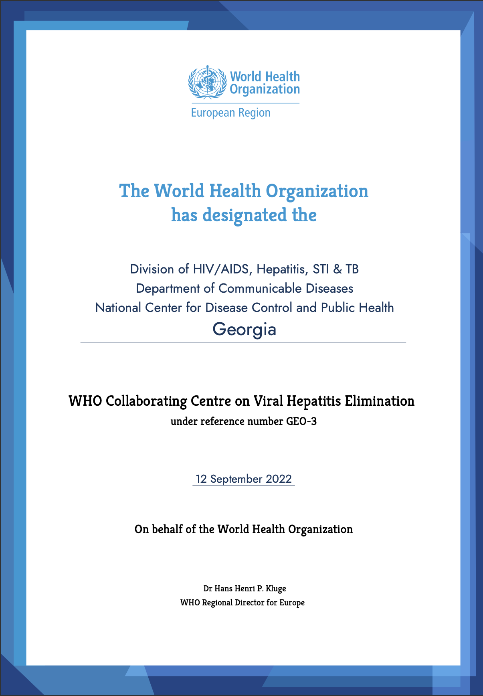
WHO Collaborating Center for Viral Hepatitis Elimination
On 12 September 2022 NCDC was designated as WHO Collaborating Centre for the elimination of viral hepatitis and will serve as a demonstration platform for the European Region on the topic.
Main goals of the WHO CC is to:
To assist WHO in supporting Member States for developing, revising and monitoring national hepatitis elimination action plans
To assist WHO in supporting Member States for improving national viral hepatitis testing strategies and strengthening diagnostic laboratory capacity

Slide 9
Conducted activities under WHO CC, 2022- 2024
01
Kyrgyzstan
Tajikistan
Uzbekistan
Study tours on Georgian experience
Azerbaijan
Moldova
Turkmenistan
Armenia
Kazakhstan
Ukraine
02
Development of strategic action plans
Development of testing and treatment guidelines
Creation of electronic registries
Trainings on simplified clinical management of Hepatitis C for PHC
Creation of methodology and protocol for national serosurveys
Technical support to member states
03
Joint mission on HIV/Hepatitis in Azerbaijan
Joint mission on HIV/Hepatitis in Albania
Joint mission on HIV/Hepatitis in Moldova
Technical support to WHO Missions

Slide 10
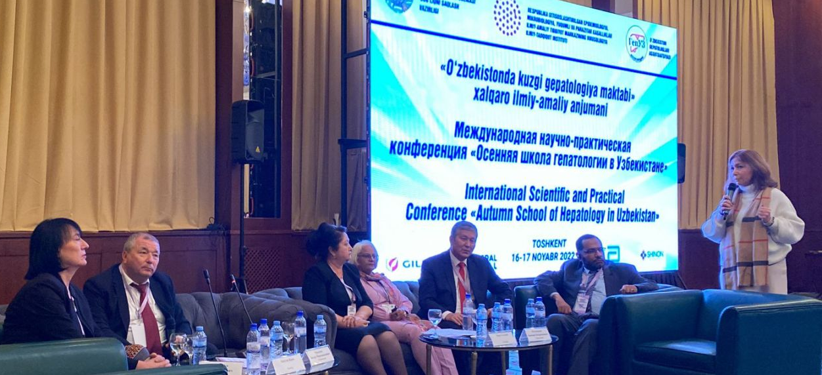
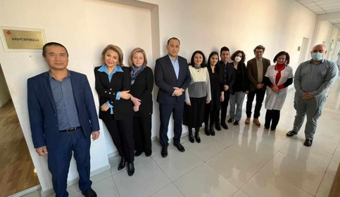
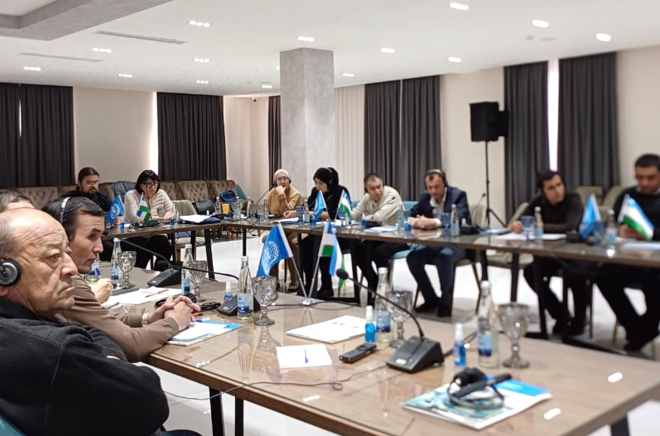
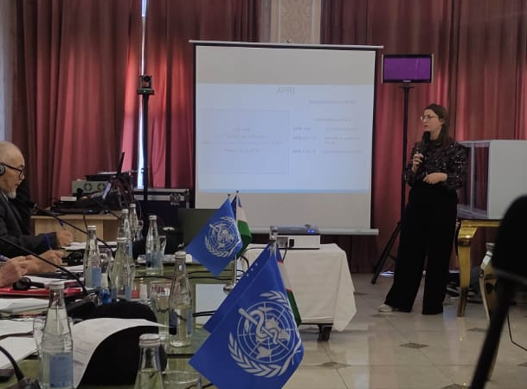
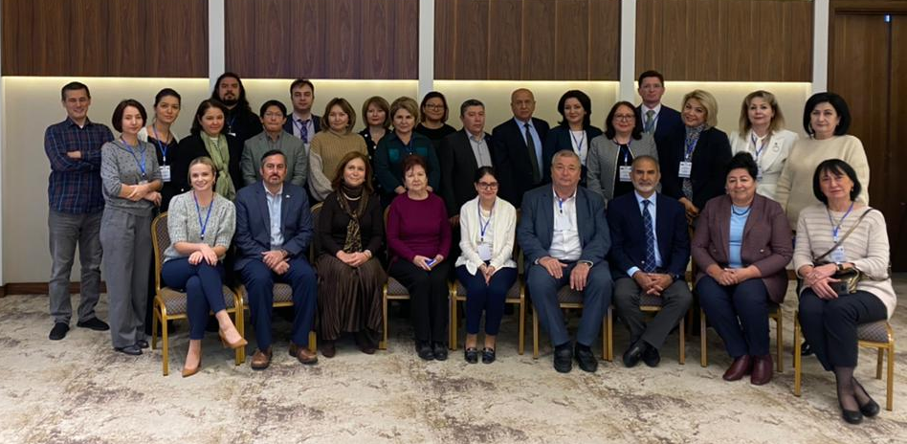
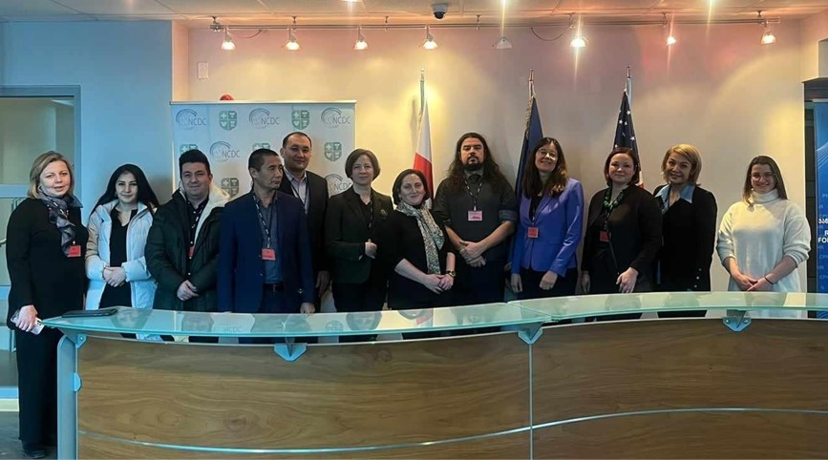
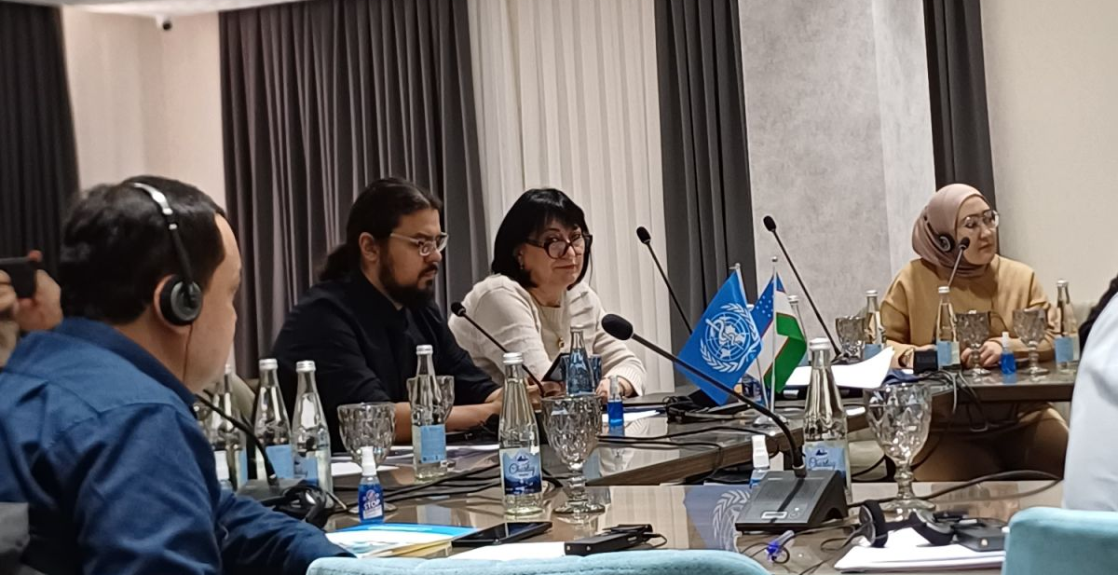
Collaboration with Uzbekistan
Under the WHO Collaborative Center activities
Uzbekistan Population-Based Serosurvey of Prevalence of and Risk Factors for SARS-CoV-2, Hepatitis C and Hepatitis B Virus Infection: key results and further steps”, 2022. Tashkent, Uzbekistan
Trainings on simplified clinical management
of Hepatitis C for PHC, 2024
Andijan & Namangan, Uzbekistan
1st Demonstration Platform Visit, 2023
Tbilisi, Georgia

Slide 11
Georgia Hepatitis C Elimination Program Care Cascade, 28 April 2015 – 30 March 2025
95.0%
88.2%
-18, 132
77.4%
Since 2015:
3 million persons tested
About 172 010 anti-HCV positive cases identified
18 709 anti-HCV+ individuals to follow-up and link to care
Over 90 421 patients started treatment
Cure rate – 99%
-13,485
95.2%
73.7%
* Among persons with national ID number. An additional 18,586 screened anti-HCV+ using an anonymized 15-digit code. Thus, their representation in the cascade cannot be confirmed; ** Age ≥12 years with no mortality data prior to progressing in cascade
*** Per-protocol, includes retreatments. Among 61,931 persons tested after their 1st round of treatment, 60,058 (97.0%) achieved SVR
(Including 82.4% for SOF-based regimens, 98.2% for SOF/LED regimens, and 98.5% for SOF/VEL regimens). 2,482 persons were retreated with a 2nd round of treatment, with 94.3% (1,296/1,375) of those tested achieving SVR. Overall SVR by Intention-to-Treat analysis: 71.8%
Notes:
SLIDE 3
This slide shows the number of people with a positive HCV test results presenting to four pilot provider sites in Tbilisi by week.
For the first four weeks of the program at least 700 people presented to the 4 sites combined, peaking during the second week at a 1000 people.
SLIDE 4
And here are the same trends by month BUT for 12 provider sites enrolled in the program as of April 18th
The peak volume of Hepatitis C –infected persons seeking care occurred in April and thereafter stabilized at approximately 2300 people per month.
SLIDE 5
This slide demonstrates number of persons with current HCV-infection and indications for treatment, who were approved by the committee ,depicted in blue
and those who started treatment depicted in orange, by month
Initially in April and April proportionally a low percentage of patients eligible to start treatment were approved. However as the process was refined, in April and April larger proportion of patients started treatment.
SLIDE 6
Here are the demographic characteristics of 3 722 people who started treatment.
86% of patients were male. Median age was 51.
Available data of Family score was equally distributed among those with less than 70.000 score and those with >70,000
SLIDE 7
Among patients who started treatment the majority resided in Tbilisi followed by Imereti and Adjara regions

Slide 12
Challenges &
Next Steps
5. Apply for the validation of Path to hepatitis C elimination
05
1. Strengthen linkage-to-care
Diagnose remaining 18 132 individuals
Treat remaining 13 485 individuals
01
04
4. Raising awareness
about hepatitis B and C infections, treatment availability and National Elimination Program
2. Strengthen infection transmission prevention
Both in general and key populations
02
03
Increase Hep B vaccination coverage
among target and key populations

Slide 13
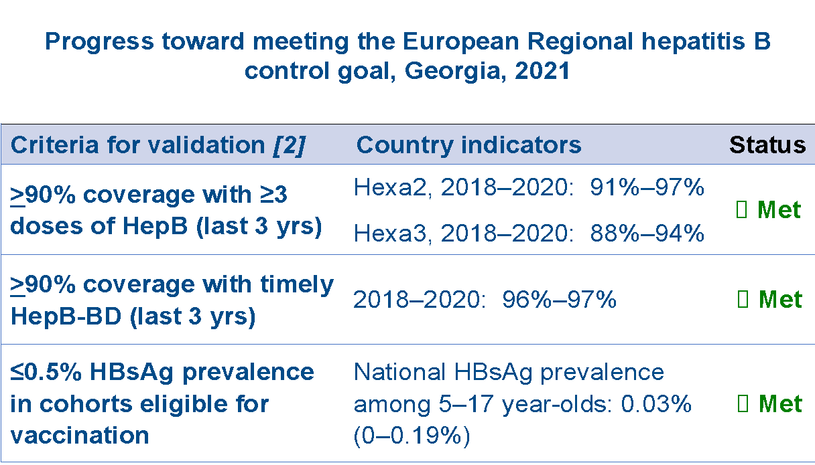
Hepatitis B Management State Program
Nationwide Serosurvey results (2015 and 2021) HBV Among Adults
In 2022 Georgia has reached regional targets for control of hepatitis B through immunization by WHO
In April 2024, the government approved the hepatitis B elimination program in Georgia:
Screening for the infection is provided free of charge under the program
Treatment (TDF, ETV) is provided under the program for eligible individuals.
The Hepatitis B vaccine is available free of charge for key populations (e.g., PWID, patients co-infected with HCV/HIV/Syphilis, healthcare workers, etc.)
HBV infection marker | 2015 Adjusted % (95% CI) | 2021 Adjusted % (95% CI)
Anti-HBc | 25.9 (24.1–27.6) | 22.6 (21.2–24.1)
HBsAg | 2.9 (2.4–3.5) | 2.7 (2.2–3.4)
Corresponds to ~78,000 adults living with chronic HBV infection in 2021 vs ~80,000 in 2015

Slide 14


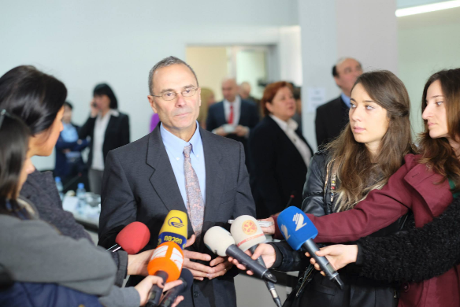
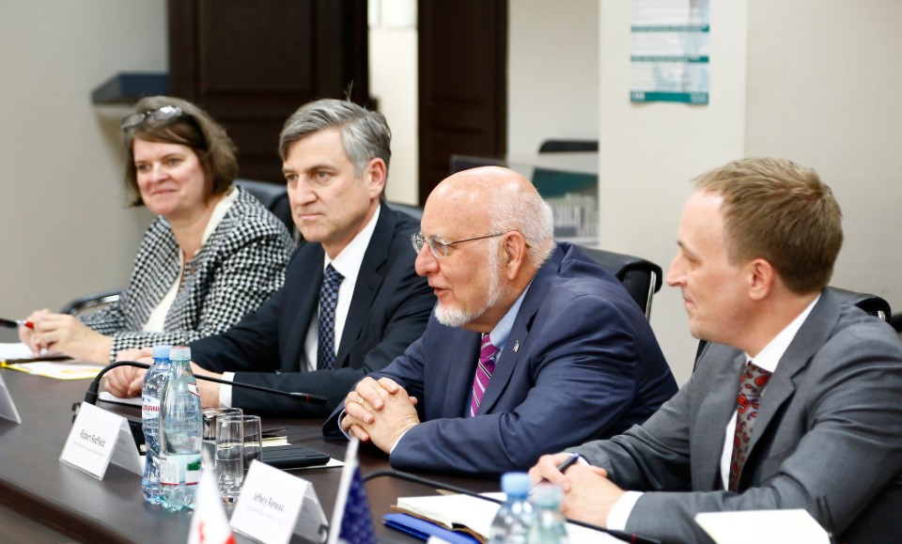
CONCLUSION
Salford & Co.
1
2
3
4
Lessons learned from the
Georgia elimination program
can inform programs in
other countries striving
to eliminate HCV as a
public health problem
HCV Elimination program has been a big driver for health system strengthening and advancing the general public health agenda in Georgia;
HCV elimination program stimulated the development of other key public health programs such as Safe Blood, Infection Control, Harm Reduction, the HIV and TB programs, etc.;
Partnership in the Georgian HCV Elimination Program is expanding, including the support of the organizations such as CDC, WHO, Gilead, Abbott, World Hepatitis Alliance, EASL, University of Bristol, The Global Fund, FIND, LIFER, and others

Slide 15
















Acknowledgements
CDC Foundation
HCV Elimination Program Providers
TAG Members

